Slide 1
INHERITANCE
Inheritance allows us to define a class in terms of another class, which makes it easier to create and maintain an application.
This also provides an opportunity to reuse the code functionality and fast implementation time.
The existing class is called the base class, and the new class is referred to as the derived class.

Slide 2
Base & Derived Classes
A class can be derived from more than one classes, which means it can inherit data and functions from multiple base classes.
Syntax:
class derived-class: access-specifier base-class

Slide 3
Program
#include <iostream>
using namespace std;
// Base class
class Shape
{
public:
void setWidth(int w)
{
width = w;
}
void setHeight(int h)
{
height = h;
}
protected:
int width;
int height;
};

Slide 4
// Derived class
class Rectangle: public Shape
{
public:
int getArea()
{
return (width * height);
}
};
int main(void)
{
Rectangle Rect;
Rect.setWidth(5);
Rect.setHeight(7);
// Print the area of the object.
cout << "Total area: " << Rect.getArea() << endl;
return 0;
}

Slide 5
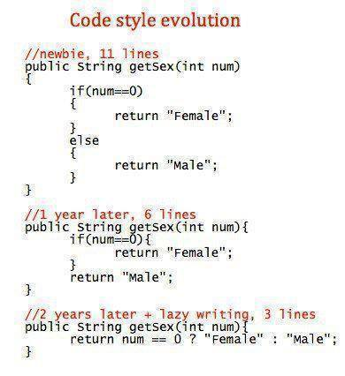

Slide 6
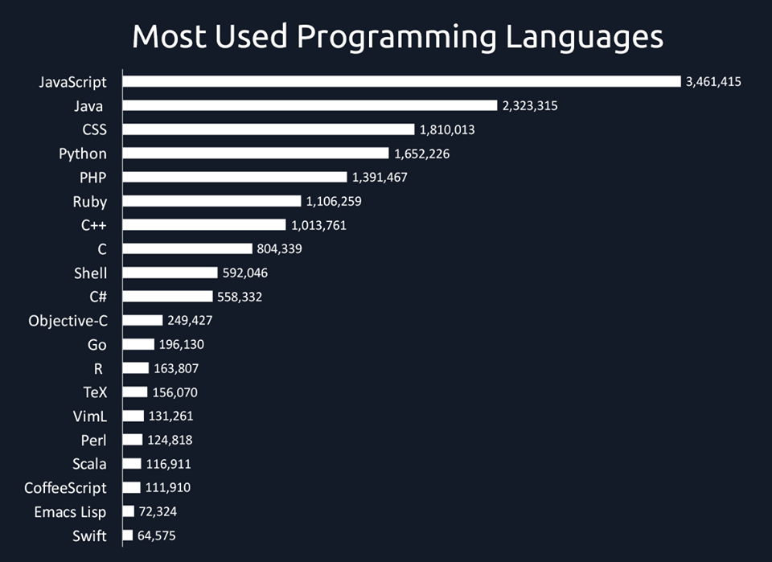

Slide 7
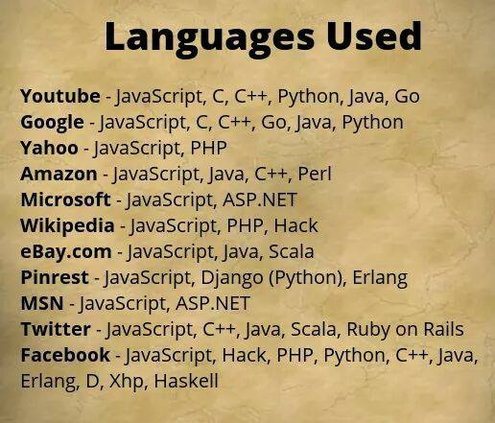

Slide 8


Slide 9
Access Control and Inheritance
A derived class can access all the non-private members of its base class.
Access | public | protected | private
Same class | Yes | yes | yes
Derived classes | Yes | yes | no
Outside classes | yes | no | no

Slide 10
Type of Inheritance
We deriving a class from a base class, the base class may be inherited through public, protected or private inheritance.
Public Inheritance :
A base class's private members are never accessible directly from a derived class, but can be accessed through calls to the public and protected members of the base class.
Protected Inheritance: When deriving from a protected base class, public and protected members of the base class become protected members of the derived class.
Private Inheritance: When deriving from a private base class, public and protected members of the base class become private members of the derived class.

Slide 11
Multiple Inheritance
Where access is one of public, protected, or private and would be given for every base class and they will be separated by comma as shown above.

Slide 12
Program
#include <iostream>
using namespace std;
// Base class Shape
class Shape
{
public:
void setWidth(int w)
{
width = w;
}
void setHeight(int h)
{
height = h;
}
protected:
int width;
int height;
};

Slide 13
// Base class PaintCost
class PaintCost
{
public:
int getCost(int area)
{
return area * 70;
}
};
// Derived class
class Rectangle: public Shape, public PaintCost
{
public:
int getArea()
{
return (width * height);
}
};

Slide 14
int main(void)
{
Rectangle Rect;
int area;
Rect.setWidth(5);
Rect.setHeight(7);
area = Rect.getArea();
// Print the area of the object.
cout << "Total area: " << Rect.getArea() << endl;
// Print the total cost of painting
cout << "Total paint cost: $" << Rect.getCost(area) << endl;
return 0;
}

